Slide 1

WIPRO NGA Program - NGA_SDET(Selenium)_25VID0810
Capstone Project Presentation -13th and 14th June, 2025
Project Title -
1.Demowebshop_Automation
2.reqres_Assured_API_Testing
Presented by - Rudwaj SK
www.rpsconsulting.in

Slide 2

Table of Contents
Project Overview
Tools and Technology
Project Design
BDD Cucumber with Page Object Mode
Rest Assured API Testing Using BDD
GitHub
Jenkins
Conclusion

Slide 3
Project Overview
DemoWebShop_Automation
This is a BDD test automation framework for the Demo Web Shop site using Java, Selenium, and Cucumber. It follows the Page Object Model (POM) design, supports cross-browser testing, uses JUnit for execution, and generates Extent Reports with screenshot-on-failure. The framework is reliable and handles dynamic web elements efficiently.
Reqres_Rest_Assured_API
This project is a dedicated API testing framework built using Java and the powerful REST Assured library. It uses JUnit to structure and execute tests for the reqres.in public API, specifically targeting the core CRUD (Create, Read, Update, Delete) operations.

Slide 4
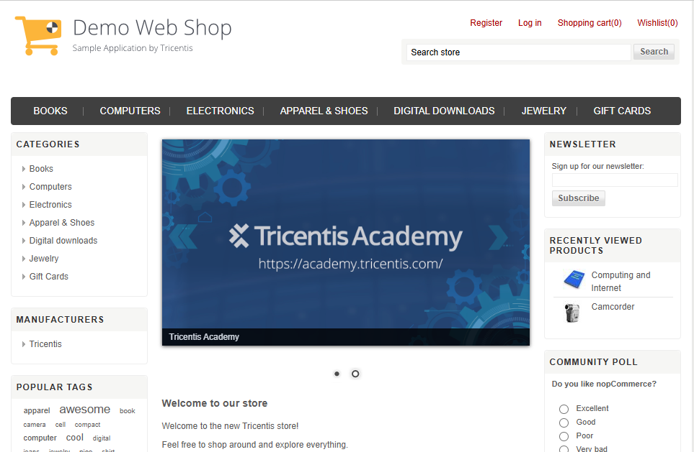
DemoWebShop

Slide 5
Tools and Techniques
Eclipse IDE
Maven
Java
Selenium
BDD Cucumber
Project Object Model
Extent Report
HTML cucumber Report
GitHub
Jenkins

Slide 6
Project Design
•Behavior-Driven Development approach (BDD)
•Page Object Model (POM)
•Data-Driven approach
•GitHub
•Jenkin

Slide 7
BDD Cucumber with Page Object Model
BDD(Behavior Driven Development)
BDD is a software development approach that focuses on defining the behavior of an application from the user's perspective using simple, natural language. Uses Gherkin Syntax to write test scenarios
CUCUMBER
It is a BDD tool that lets you write test cases in plain English using Gherkin syntax. It Connects those steps to actual code that performs actions
PAGE OBJECT MODEL(POM)
It is a design pattern used in Selenium test automation frameworks to create an object repository for web elements. It enhances code reusability, readability and mantainability.

Slide 8
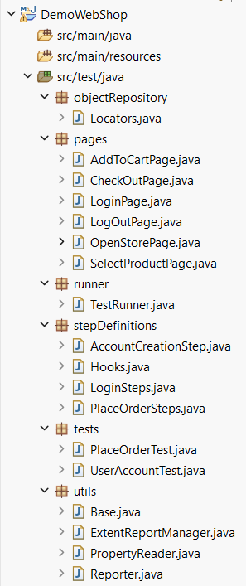
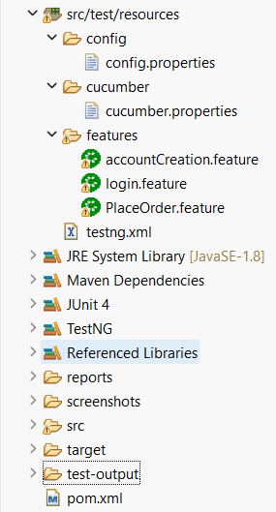
Project Structure of Demowebshop_BDD

Slide 9
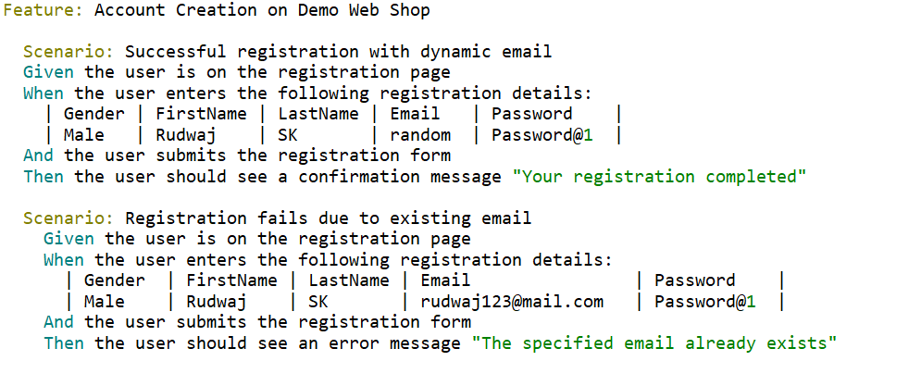
Screenshot of AccountCreation.feature

Slide 10
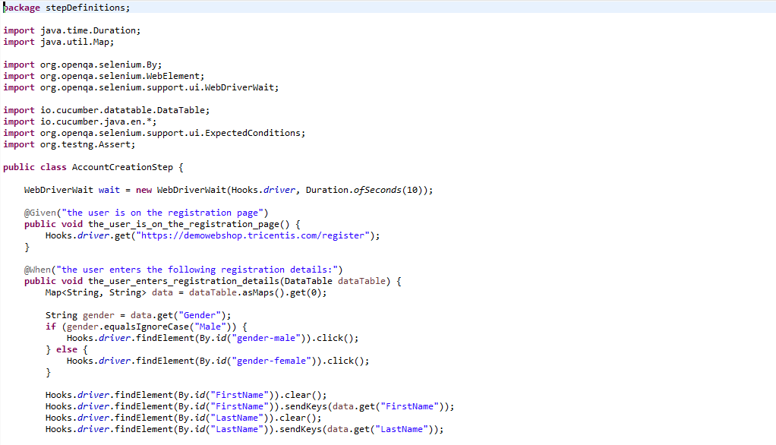
Screenshot of AccountCreationSteps.java

Slide 11
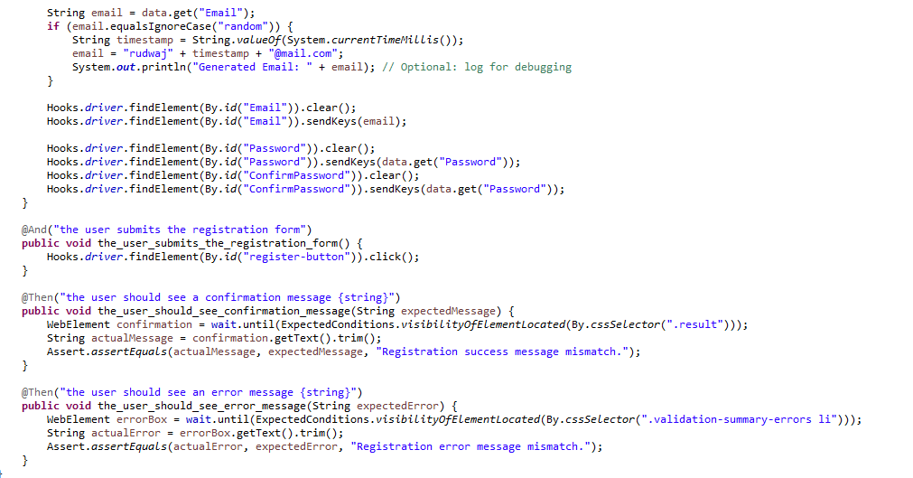
Screenshot of AccountCreationSteps.java

Slide 12
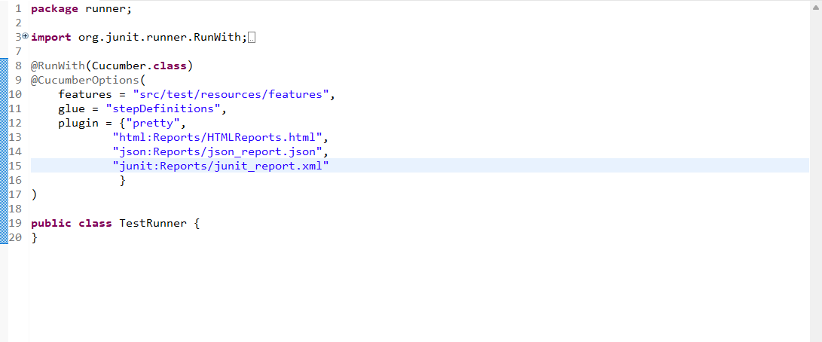
Screenshot of TestRunner file

Slide 13
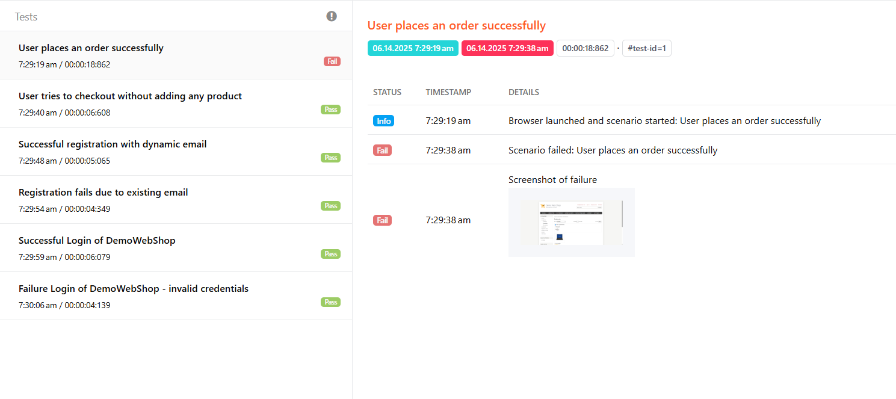
Screenshot of Extent Report

Slide 14
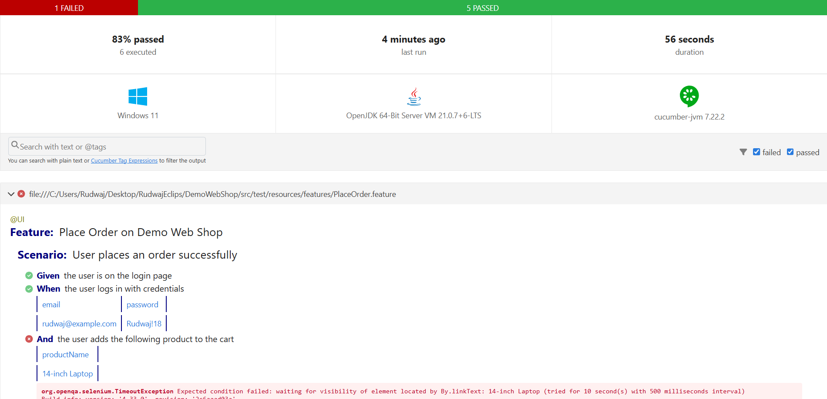
Screenshot of Cucumber Report

Slide 15
Reqres_API_Rest_Assured
https://reqres.in/api/users

Slide 16
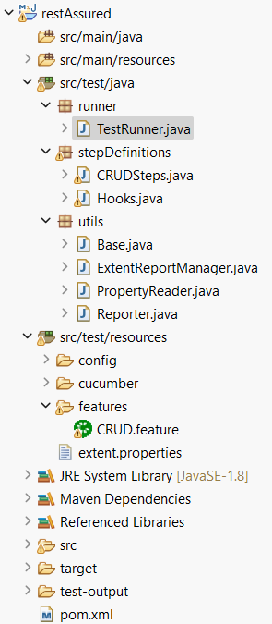
Project Structure Rest_Assured

Slide 17
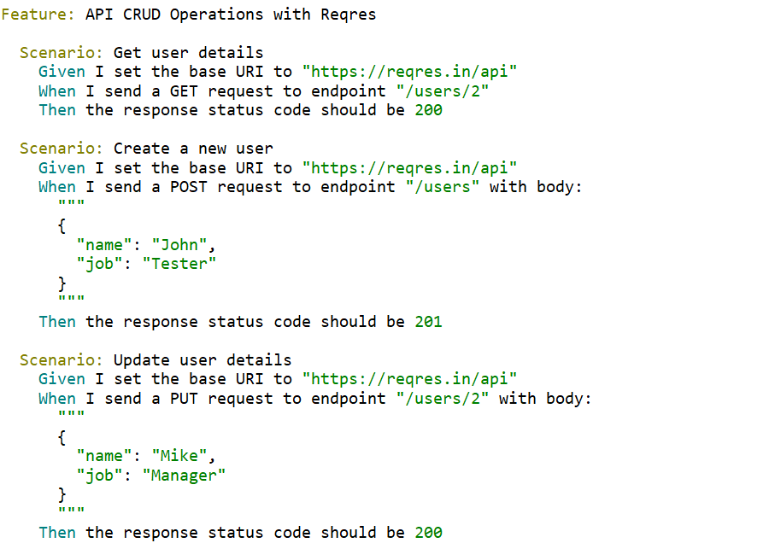
Screehshot of CRUD.feature

Slide 18
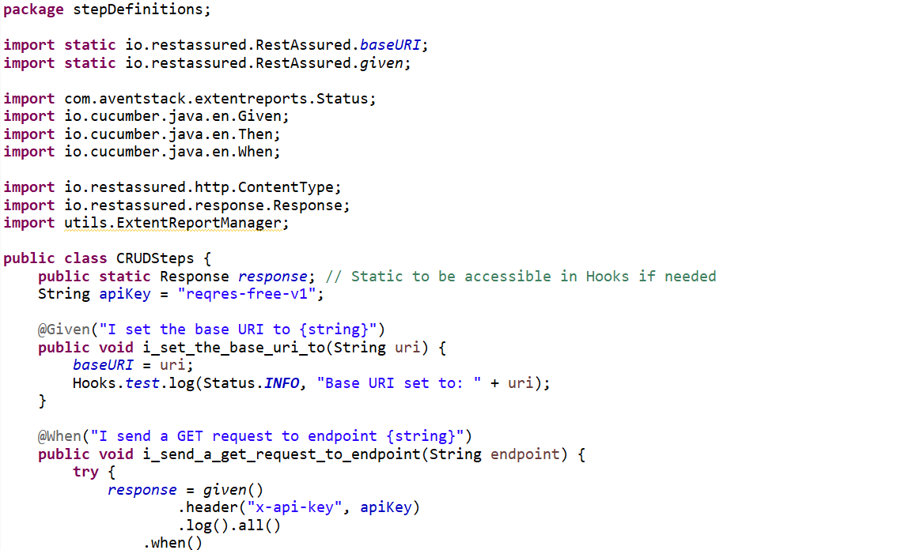
Screenshot of CRUDSteps

Slide 19
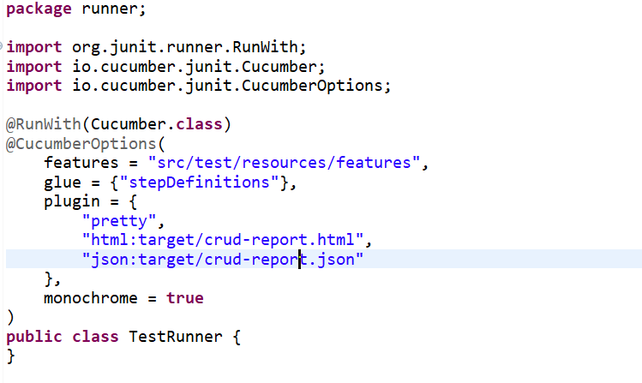
Screenshot of TestRunner File

Slide 20
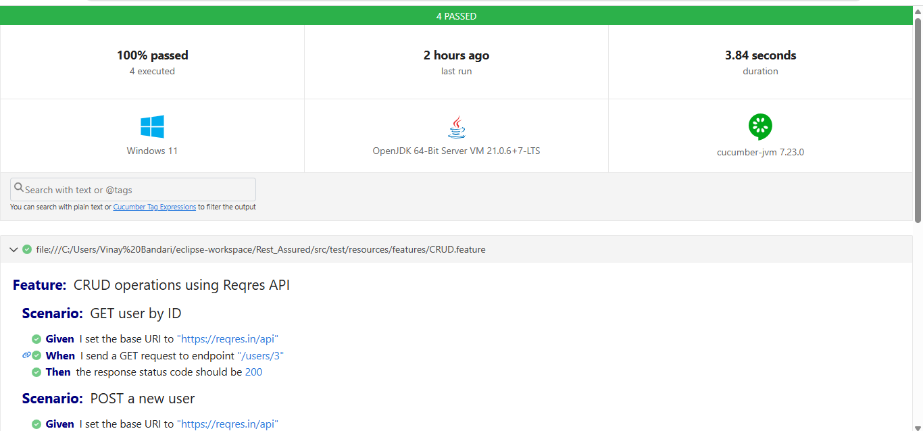
Screenshot of Cucumber Report

Slide 21
GitHub Screenshot

Slide 22
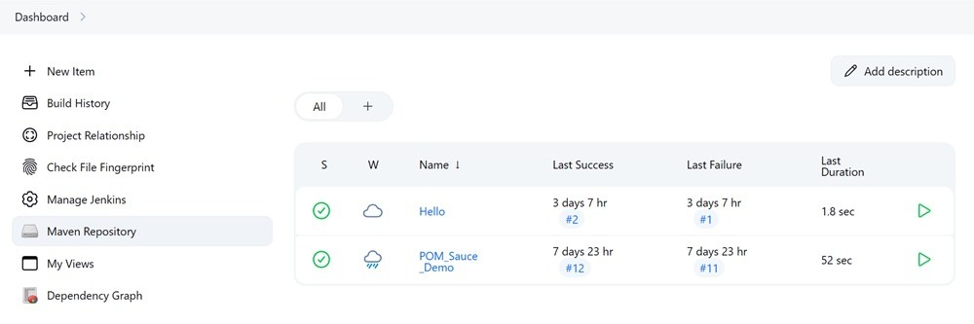
Jenkins Screenshot

Slide 23
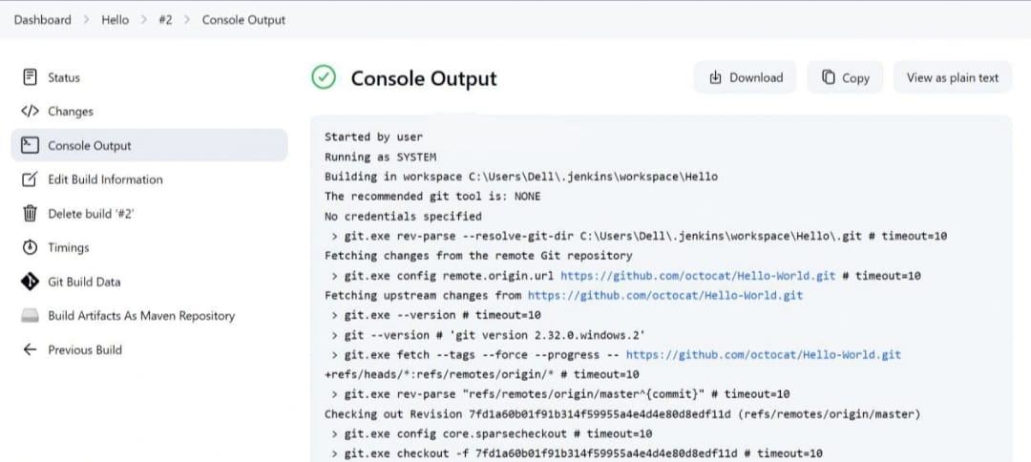
Jenkins Screenshot

Slide 24
Conclusion
Demowebshop_Automation
This framework successfully automates critical user journeys like registration, login, and end-to-end order placement. The use of BDD makes the tests highly readable for both technical and non-technical stakeholders. By solving real-world challenges like synchronization and browser pop-ups, the project proves to be a complete and stable solution for UI regression testing, providing clear and actionable feedback through its detailed reports.
Reqres_Rest_Assured_API
This framework effectively tests core backend services, demonstrating the ability to automate API-level validations. It highlights a clean and efficient approach to backend testing, complementing front-end automation skills.

Slide 25
THANK YOU

